Slide 1
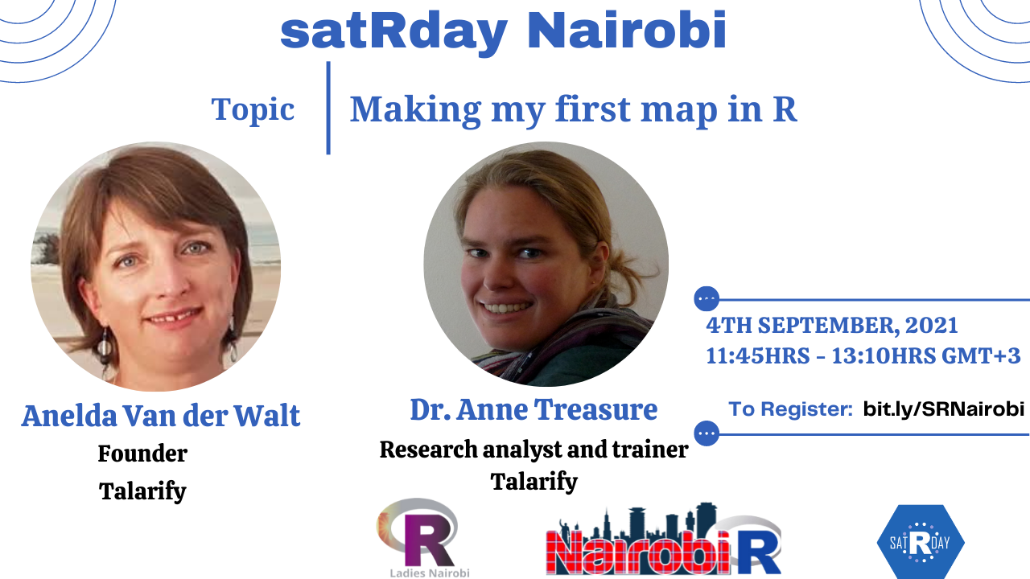

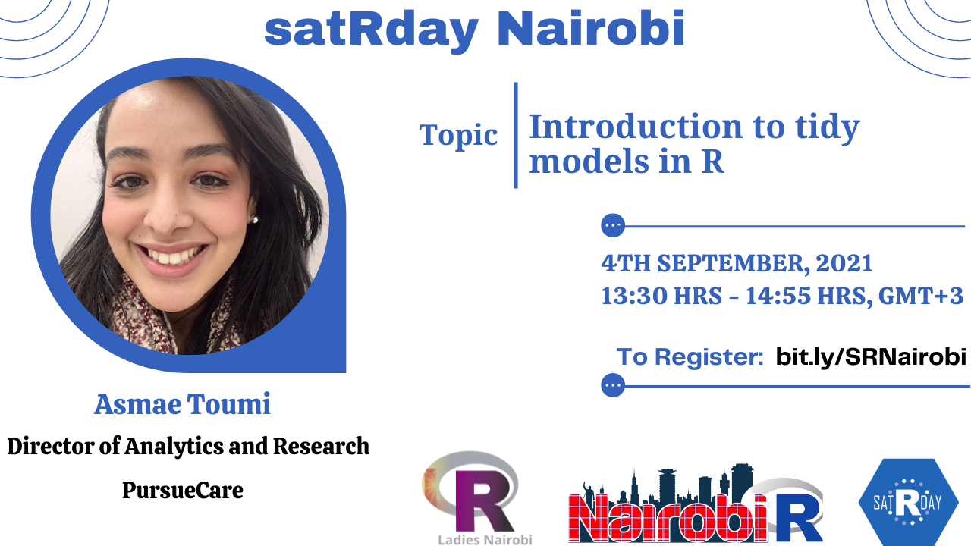

Slide 2
Agenda
Time | Activity | Speaker/ Moderator
13:30 pm | Participants joining
13:30 am - 13:35 pm | Welcoming remarks and introducing the speaker | Shelmith Kariuki/Faith Musili
13:30 pm – 14: 40 pm | Introduction to tidy models in R | Asmae Toumi
14:40 pm - 14:55 pm | Q & A | Asmae Toumi Shelmith Kariuki/Faith Musili

Slide 3
Training Session

Slide 4
Q & A

Slide 5




THANK YOU
Email address: nairobi@rladies.org
LinkedIn: R-Ladies Nairobi
Twitter: @RLadiesNairobi/ #NairobiR
Meetup: https://www.meetup.com/rladies-nairobi/

